Slide 1
Name: Kabilarasan Roll no: 1812576035
Mid Term Report

Slide 2
Predictive Model for water pumps
functionality in Tanzania

Slide 3
PROBLEM STATEMENT
This starts with analyzing the functional status of the available water points in Tanzania. In this analysis we will be looking into the dataset of water pumps in Tanzania to predict the operating condition of a water point. which brings us to the inspiration to the analysis.
By Predicting which water pump is functioning but need repairing , the cost of maintenance of water pump can be reduced and the availability of water in Tanzania can be improved.

Slide 4
APPROACH
My first approach was to find those features which would be important in predicting the result. Intiutively we know that the location and the population around any particular water point would play vital role in the status of that water point.
But there was problems as features like gps_height,population,latitude and longitude had many missing data points, so I missed filled those missing data points with the mean and median(as required) of the respective feature in that particular district in which it was lying. So, I have visualised to check the relationship between the features.

Slide 5
The group of features of (extraction_type, extraction_type_group, extraction_type_class), (payment, payment_type), (water_quality, quality_group), (source, source_class), (subvillage, region, region code, district_code, lga, ward), and (waterpoint_type, waterpoint_type_group) all contain similar representation of data in different grains. Hence, we risk overfitting our data during training by including all the features in our analysis, which can be dropped.
Since our target is to predict the pump which requires the repair. So, we label other two labels functional and nonfunctional as one label and making the problem as a binary classifier.

Slide 6
Data Understanding :
We have 40 predictor variables. Out of the 40 features in the dataset, we have 31 categorical variables, 7 numerical variables, and 2 date variables.
The water pumps are either of these three categories
functional,
non-functional, or
functional but need repair.
We labeled both non-functional and functional as func_non_func to make the problem simple and focus more on our problem.
We have 7% functional but need repair class and 93% functional and non_functional class

Slide 7
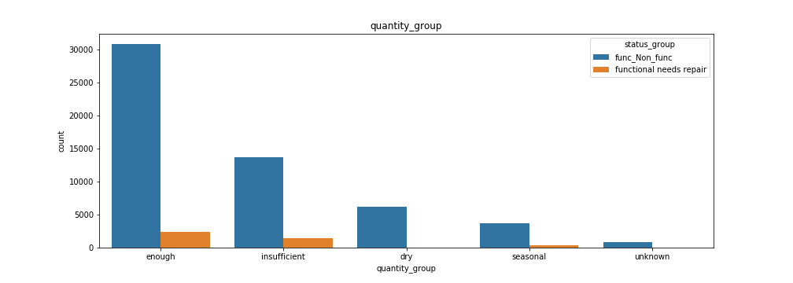

Slide 8
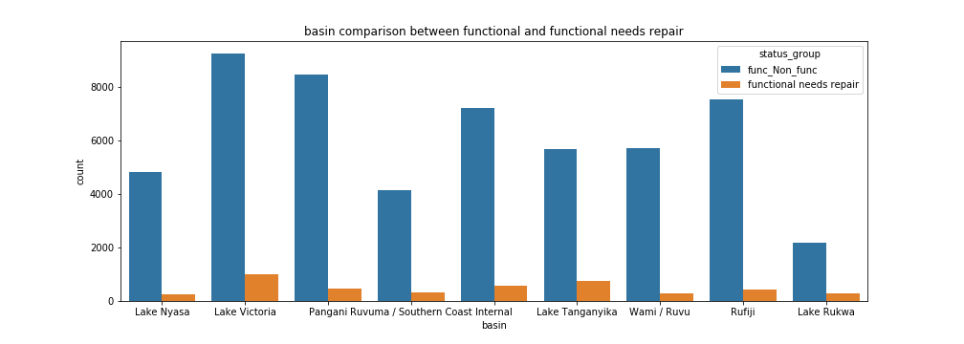

Slide 9
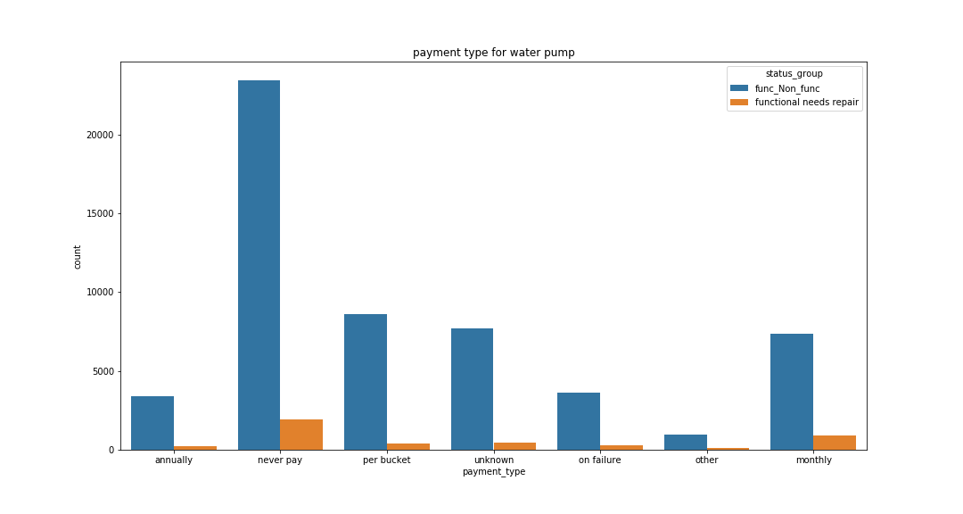

Slide 10
Data Preparation:
The group of features of (extraction_type, extraction_type_group, extraction_type_class), (payment, payment_type), (water_quality, quality_group), (source, source_class), (subvillage, region, region_code, district_code, lga, ward), and (waterpoint_type, waterpoint_type_group) all contain similar representation of data in different grains. Hence, we risk overfitting our data during training by including all the features in our analysis, which can be dropped.
The dataset contains a lot of categorical features which is nominal data so we need to create dummies for those categorical features to train the model using this dataset.

Slide 11
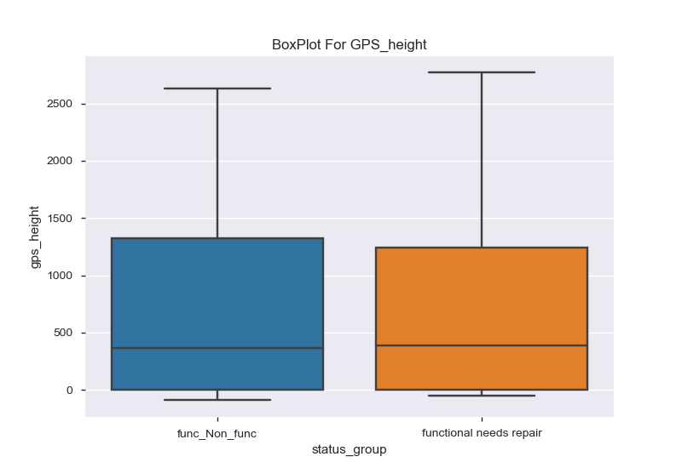
Data Preparation:
since the gps_height is having almost simliar distribution for both class in status group, this variable will not be helpful for us to classify.so, i dropped this variable.

Slide 12
Selection of model
Since our goal is to predict the pump which needs repair,to make the classification simple I converted the three label problems to binary classification problem.
I tried to build the model using Logistic Regression, Decision Tree, Random Forest,ExtraTreeClassifier, Naïve bayes classification model. Because of imbalanced Data f_1 score , recall, precision would be the appropriate performance metrics.
Naïve bayes performed well for this data than other classification model.

Slide 13
Random Forest Classification_Report:
precision recall f1-score support
func_Non_func 0.94 0.97 0.95 8143
functionalneeds repair 0.33 0.20 0.25 671
Naïve bayes Classification_Report:
precision recall f1-score support
func_Non_func 0.97 0.57 0.72 8243
functional needs repair 0.11 0.74 0.18 571

Slide 14
Since we can find the 72 percentage of positive classes using this naïve bayes and while comparing other classification models this model performed good and able to give some useful outputs. So I conclude this naïve bayes model as a appropriate model for this data to classify.

